Slide 1
Artkick
November 12, 2012
0.6
Sheldon Laube
sjlaube@gmail.com

Slide 2
1. Document History
No. | Sent | Version | File Name | Contents
1 | 2010.12.07 | Draft | SRD_FDF_Draft_101207.ppt | Initial document
2 | 2010.12.08 | v.0.1 | SRD_FDF_101208.ppt | p.2 Add Document History page
3 | 2011.03.16 | v.0.2 | [app title]description_YYMMDD.ppt | Translation into English
4 | 2011.07.25 | v.0.3 | [app title]description.ppt | Simplified the document
5 | 2012.04.02 | v.0.4 | [app title]description.ppt | Add the pages for detailed AD information
6 | 2012.08.27 | v0.5 | [app title]description.ppt | Updates document
7 | 2012.11.12 | V0.6 | [app title]description.ppt | Updates document

Slide 3
2. Basic Information
App Title | Artkick
Category | Entertainment – Photo display
Video Resolution | 1920x1080
Application Type | Web HTML/Javascript
Service Area | Worldwide
Supported Language | English
Sound | BGM (No), Sound Effects (No)
Geo-IP Blocking | No
Contents Size | 400K
Application URL address (Web Apps Only)
AD Type (AD Serving Apps based on LG AD Platform Only) | No ADs
Detailed App. Information. | This is a two screen application which displays art on the LG SmartTV . User controls what is displayed on the TV by using an IOS or Android device You must download Artkick from either the IOS or Google play store and register yourself When you start application on TV it will present a registration code to be entered into the Artkick app You can then display over 50,000 fine art images from museums around the world, share them with social media, and create your personal viewlists of your favorites. There is no UI on the TV, except for the registration screen. All control is done by the phone or tablet. However the user can use the TV remote forward and back buttons to change the image on the TV screen. The TV will keep displaying art even after the user turns off their phone or tablet. The goal is to turn the TV into an interactive picture frame.
Notes 1. Correct and detailed Basic Information required for App QA. 2. Detailed scenario of button or menu’s function required for App QA. 3. Game Apps: If there is sound, detailed description of BGM / Sound Effects, etc. required. 4. Game Apps: Detailed description of “How to Play” required. 5. If you indicate Geo-IP Blocking as “Yes” you must white list the range of IPs required by the QA Team for testing. Please request the range of IPs to white list through the Seller Lounge 1:1 Inquiry.

Slide 4
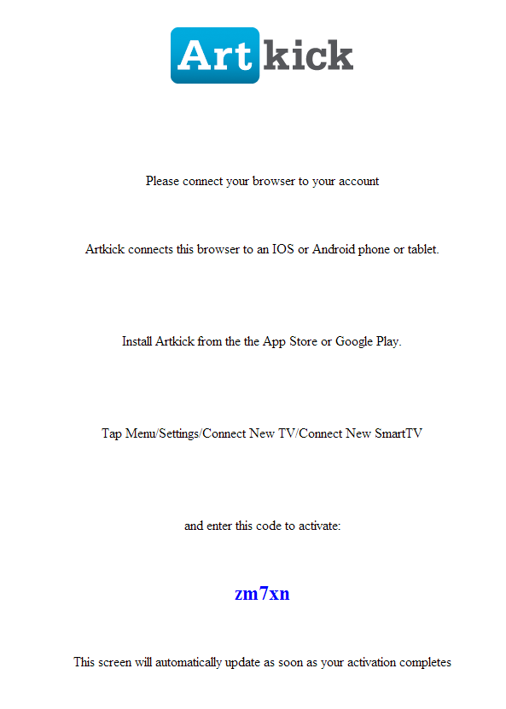
3. Detailed Registration Page Description
Description
1 | Displays first time user starts Artkick on the TV
Detailed Information
(Please write the detailed information for the above page here, if needed.
This screen appears the first time the user starts the Artkick app on the TV. The user then needs to install the IOS or Android app on their phone or tablet. User can register themselves, Artkick is a free app. After logging into Artkick on the phone or tablet the user taps menu/Connect new TV and enters a name for the TV and a Registration code. The TV is linked to their phone/tablet and now displays the art chosen by the phone/tablet.

Slide 5

4. Sample Art Page
Description
Detailed Information
An image will be displayed on the TV corresponding to which image is chosen on the phone or tablet.

Slide 6
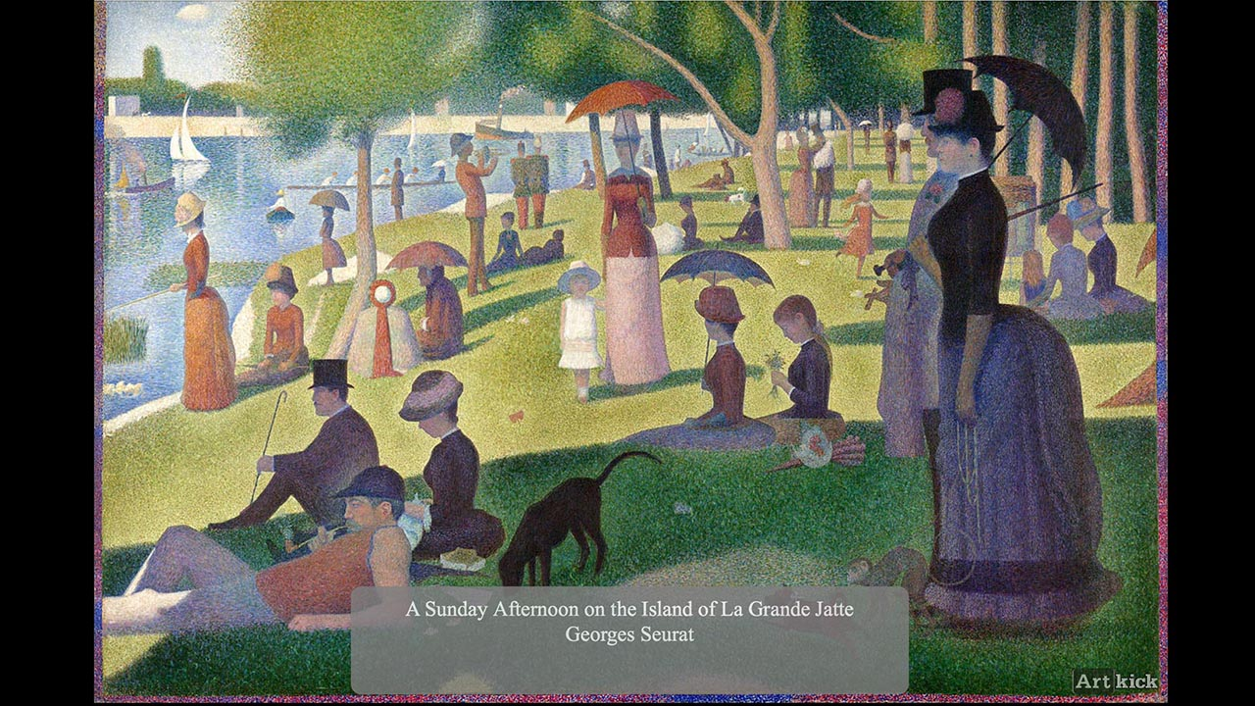
5. Sample Art Page 2
Description
Detailed Information
An image will be displayed on the TV corresponding to which image is chosen on the phone or tablet.

